Slide 1


JAIN COLLEGE OF ENGINEERING, BELAGAVI.
(Approved by AICTE, New Delhi, Affiliated to VTU, Belagavi)
BE Programme in “Electrical and Electronics Engineering” NBA Accredited
Department of Electrical & Electronics Engineering
Project Phase 1 – BEE685
FINAL PRESENTATION
“Diagnosis of Fault monitoring of Small Wind
Turbine using Iot ”
Presented By
1. Prafull P Katariya 2JI22EE029
2. Santosh Desai 2JI22EE038
3. Sachin Nandaganvi 2JI22EE033
4. Prajwal Walishetti 2JI23EE403
Under the Guidance of
Prof. Ashok Bhajantri

Slide 2
CONTENT
Chapter 1: Introduction to the project work
Chapter 2: Literature review and Summary Table
Chapter 3: Proposed Method
Chapter 4: Investigation on Components
References

Slide 3
Chapter 1: Introduction to the Project Work
Introduction
Aim of the project [title]
Objectives of the project
[hardware, software and performance testing]

Slide 4
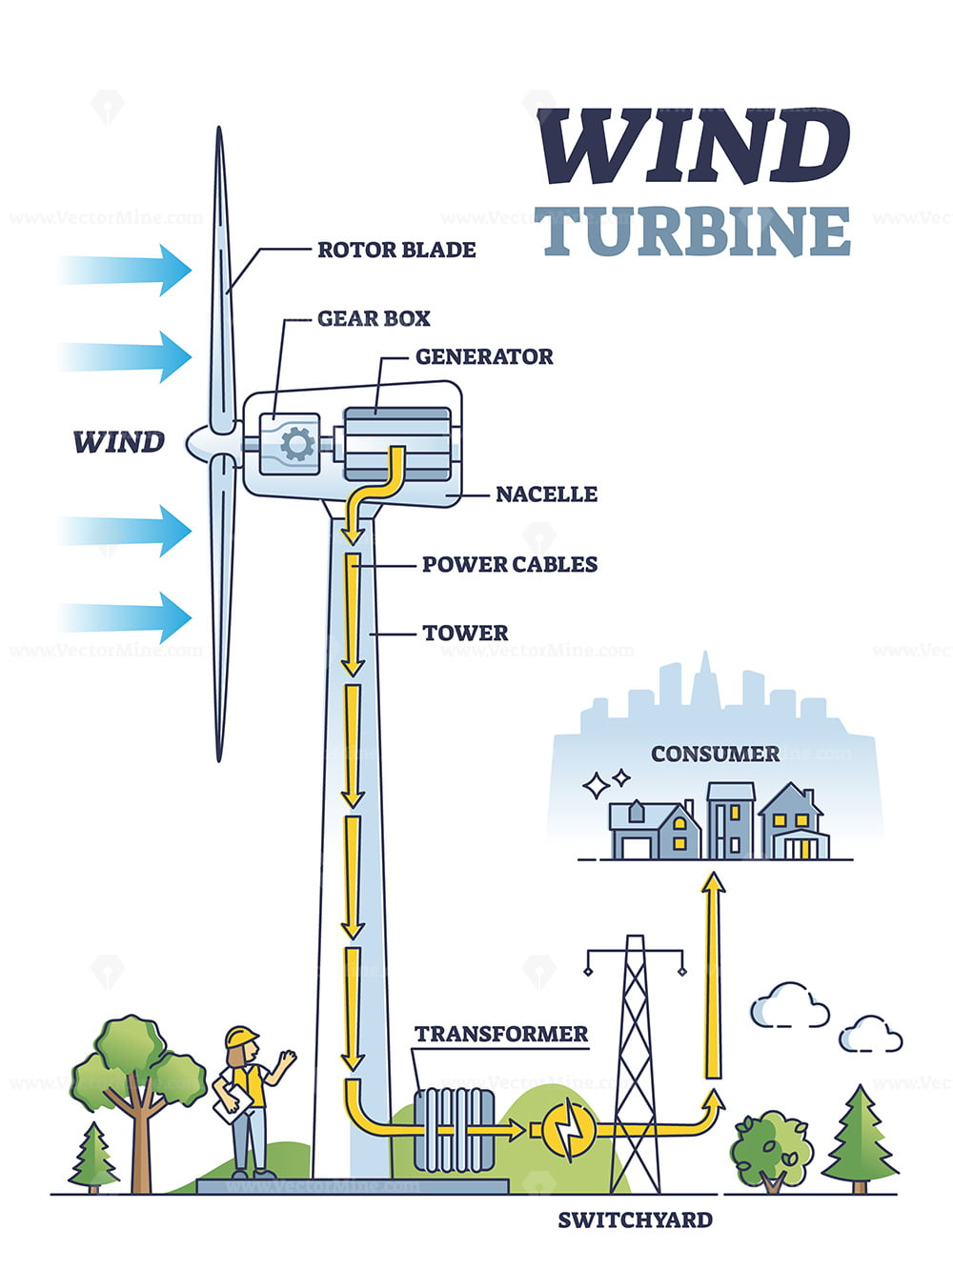
Chapter 1: Introduction
Project Topic : Affordable and Clean Energy [SDG = 7 , 13 ]
One of the Problem in Small Wind Turbine
the generator may overheat due to electrical faults or mechanical inefficiencies.
Overheating can lead to insulation damage, reduced efficiency, or complete failure of the generator.
Poor ventilation or cooling system failure.
Possible Solutions:
Condition Monitoring with Temperature Sensors.
Install thermal sensors on the generator housing and windings.
Trigger alarms or automatic shutdown when temperature exceeds a threshold.
Vibration and Current Signature Analysis
Fig: [1.1]

Slide 5
Chapter 1: Aim of the Project
To design and develop real time fault monitoring system for small wind turbine utilizing Internet of Things

Slide 6
Chapter 1: Objectives of the Project
To design an IoT-based sensor network such as vibration, temperature, rotor speed, and generator output in small wind turbines to detect early signs of mechanical or electrical faults.
To develop a fault detection system using microcontrollers such as Arduino and sensors integrated with IoT platforms for remote diagnostics and alerting.
To analyse the collected sensor data using statistical techniques to classify, predict, and visualize different fault conditions such as bearing wear, blade imbalance and generator.

Slide 7
Chapter 2: Literature Review
Literature Review*
Summary table

Slide 8
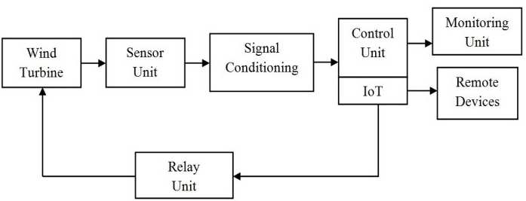
Chapter 2: Literature Review
2.2.1. Paper 1 [Intelligent Monitoring and Control of Wind Turbine Prototype Using Internet of Things (IoT)]
Methodology: BLOCK DIAGRAM
Figure. 2.2.1. Block Diagram of the Intelligent Monitoring[1]

Slide 9
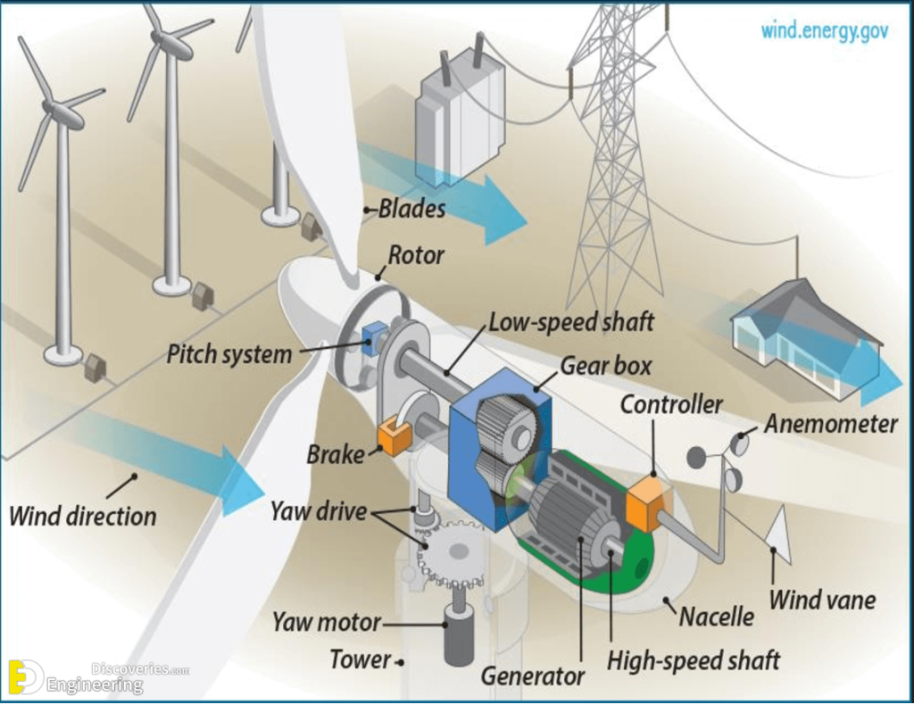
Chapter 2: Literature Review
2.2.2. Paper 2 [IOT-Enabled Fault Diagnosis and Monitoring for Small Wind Turbine]
Methodology: BLOCK DIAGRAM
Figure. 2.2.2. Block Diagram of the IOT-Enabled Fault Diagnosis[2]

Slide 10
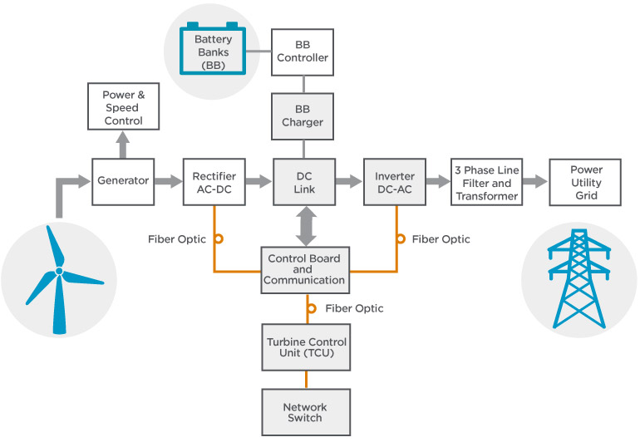
Chapter 2: Literature Review
2.2.3. Paper 3 [Fault Diagnosis and Monitoring of Small Wind Turbine ]
Methodology: BLOCK DIAGRAM
Figure. 2.2.3. Diagram of the Fault and Monitoring of Small Wind Turbine [3]

Slide 11
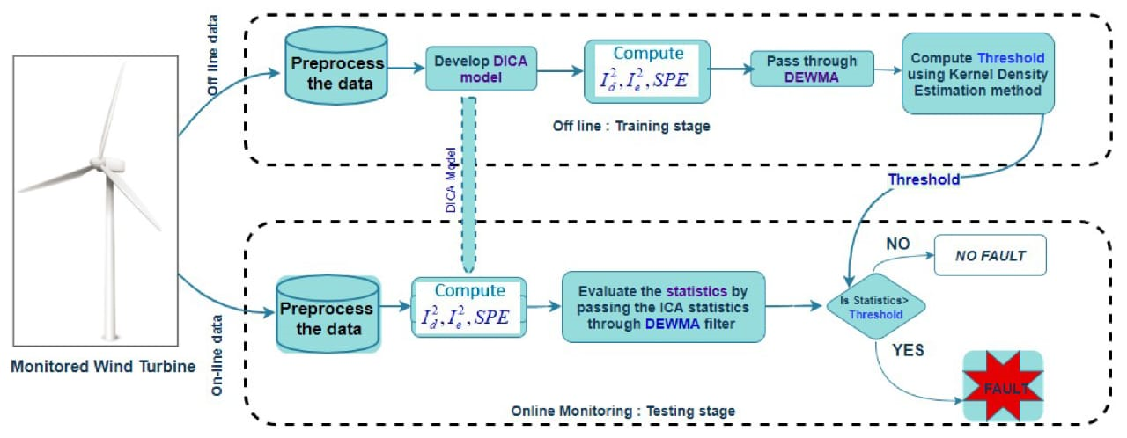
Chapter 2: Literature Review
2.2.4. Paper 4 [ Fault Diagnosis and Monitoring of Small Wind Turbine Using IOT ]
Methodology: BLOCK DIAGRAM
Figure. 2.2.4. Block Diagram of the Monitoring of Small Wind Turbine Using IOT[4]

Slide 12
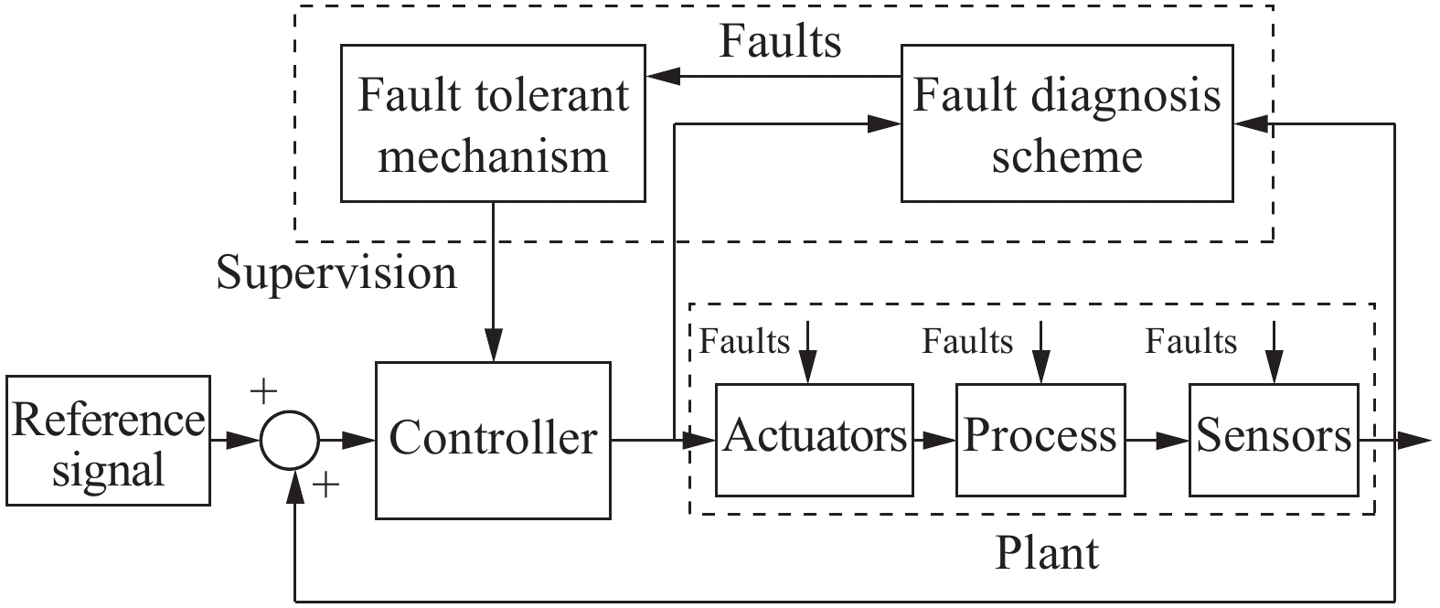
Chapter 2: Literature Review
2.2.5. Paper 5 [Fault Detection and Isolation in Wind Turbines:Type-3 Fuzzy Logic Systems and Adaptive Random Search Learning ]
Methodology: BLOCK DIAGRAM
Figure. 2.2.5. Block Diagram of the Fuzzy Logic Systems[5].

Slide 13
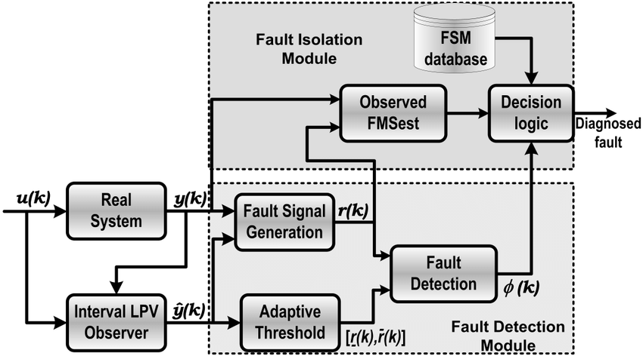
Chapter 2: Literature Review
2.2.6. Paper 6 [An Early Fault Detection Framework for Wind Turbines using Vibration Signals]
Methodology: BLOCK DIAGRAM
Figure. 2.2.6. Block Diagram of the An Early Fault Detection[6] .

Slide 14
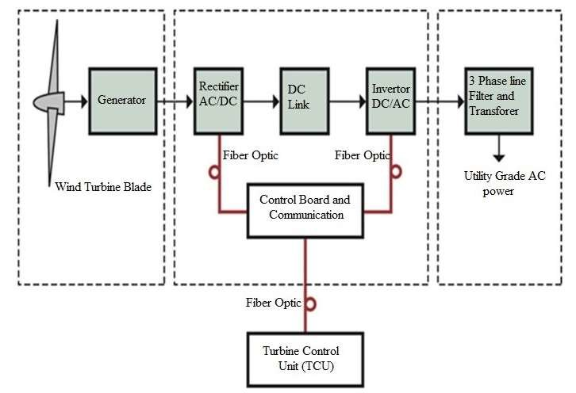
Chapter 2: Literature Review
2.2.7. Paper 7 [Vibration Analysis for Fault Detection of Wind Turbine Drivetrains—A Comprehensive Investigation]
Methodology: BLOCK DIAGRAM
Figure. 2.2.7. Block Diagram of Vibration Analysis for Fault Detection[7]

Slide 15
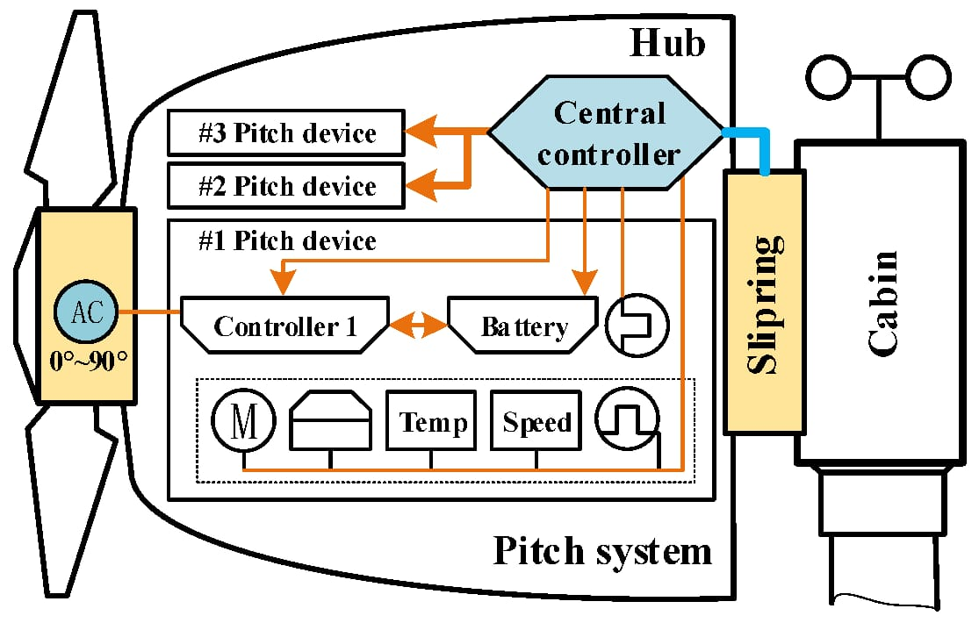
Chapter 2: Literature Review
2.2.8. Paper 8 [A methodological approach for detecting multiple faults in wind turbine blades based on vibration signals and machine learning]
Methodology: BLOCK DIAGRAM
Figure. 2.2.8. Block Diagram of multiple faults Detection[8]

Slide 16
Chapter 2: Literature Review
2.2.9. Paper 9 [Deep Learning Method for Fault Detection of Wind Turbine Converter]
Methodology: BLOCK DIAGRAM
Figure. 2.2.9. Block Diagram Deep Learning Method faults Detection[9]

Slide 17
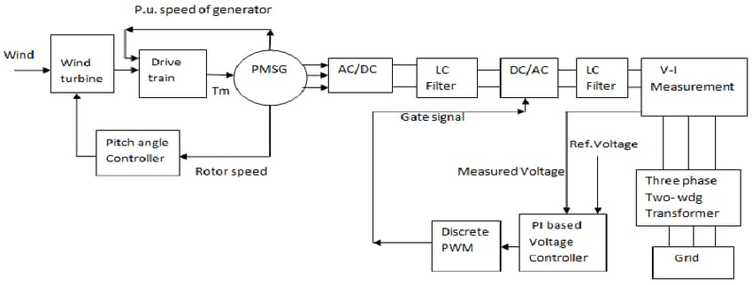
Chapter 2: Literature Review
2.2.10. Paper 10 [A Review of Recent Advances in Wind Turbine Condition Monitoring and Fault Diagnosis]
Methodology: BLOCK DIAGRAM
Figure. 2.2.10. Block Diagram Condition Monitoring and faults Detection[10]

Slide 18
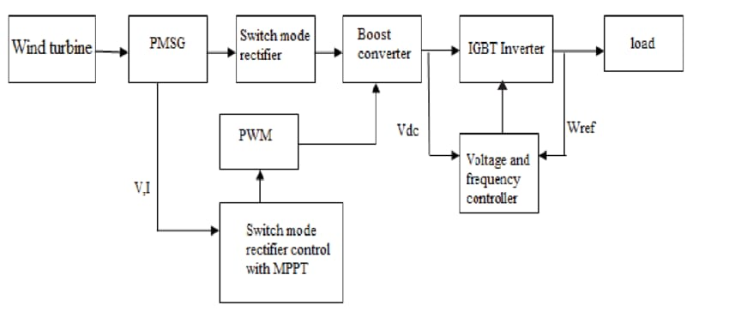
Chapter 2: Literature Review
2.2.11. Paper 11 [Fault Diagnosis of a Wind Turbine]
Methodology: BLOCK DIAGRAM
Figure. 2.2.11. Block Diagram faults Detection of a Wind Turbine [11]

Slide 19
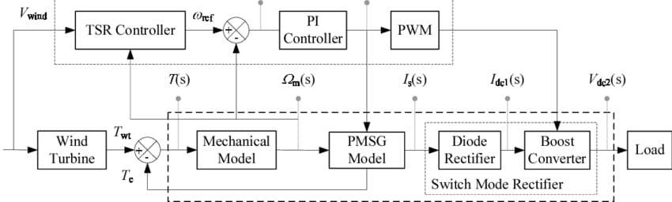
Chapter 2: Literature Review
2.2.12. Paper 12 [A review on wind turbines gearbox fault diagnosis
Methods.]
Methodology: BLOCK DIAGRAM
Figure. 2.2.12. Block Diagram on wind turbines gearbox fault Detection[12]

Slide 20
Chapter 2: Summary Table
Sl. No | Title of the Journal Paper | Year Published | Methodology Used | Advantages | Drawbacks
1 | Intelligent Monitoring and Control of Wind Turbine Prototype Using Internet of Things (IoT) | 2022 | IoT-based sensors and controllers to collect real-time wind turbine data, process it via cloud or edge computing. | Enables remote monitoring, predictive maintenance, efficiency optimization, and reduced costs. | Requires stable internet connectivity, poses cybersecurity risks, and may involve high initial setup costs.
2 | IOT-Enabled Fault Diagnosis and Monitoring for Small Wind Turbine | 2025 | IoT-enabled sensors collect real-time data on wind turbine parameters (vibration, temperature) | Enables predictive maintenance, reduces downtime, and enhances efficiency. | High initial costs, cybersecurity risks, and dependency on stable internet connectivity.

Slide 21
Chapter 2: Summary Table
Sl. No | Title of the Journal Paper | Year Published | Methodology Used | Advantages | Drawbacks
3 | Fault Diagnosis and Monitoring of Small Wind Turbine | 2024 | sensor-based condition monitoring, signal processing and AI-based fault detection for early diagnosis. | Early fault detection, reduced maintenance costs, and increased turbine lifespan. | High initial setup cost, complexity in data interpretation, and potential sensor failures.
4 | Fault Diagnosis and Monitoring of Small Wind Turbine Using IOT | 2023 | IoT-based sensors monitor wind turbine parameters and transmit data to a cloud-based system for real-time fault detection using machine learning or threshold-based analysis. | Enables remote monitoring, predictive maintenance, and reduces downtime by identifying faults early. | Requires stable internet connectivity, initial setup costs, and potential cybersecurity risks.

Slide 22
Chapter 2: Summary Table
Sl. No | Title of the Journal Paper | Year Published | Methodology Used | Advantages | Drawbacks
5 | Fault Detection and Isolation in Wind Turbines:Type-3 Fuzzy Logic Systems and Adaptive Random Learning | 2024 | Uses three-dimensional uncertainty modeling for fault detection, improving robustness and accuracy. | Handles high uncertainty, enhances fault classification | High computational complexity, requires expert knowledge.
6 | An Early Fault Detection Framework for Wind Turbines using Vibration Signals | 2024 | vibration signal analysis with machine learning models to detect faults in wind turbines early. | Provides real-time monitoring, reduces maintenance costs, and prevents catastrophic failures. | Limited by sensor accuracy, high computational demands, and potential false positives.

Slide 23
Chapter 2: Summary Table
Sl. No | Title of the Journal Paper | Year Published | Methodology Used | Advantages | Drawbacks
7 | Vibration Analysis for Fault Detection of Wind Turbine Drivetrains—A Comprehensive Investigation | 2023 | Sensors measure vibrations in components like the gearbox and generator, and signals | Early, precise fault detection and continuous monitoring. | High cost, complex analysis, and sensitivity to noise and sensor placement.
8 | A methodological approach for detecting multiple faults in wind turbine blades based on vibration signals | 2022 | Vibration signals from turbine blades are collected and processed to extract features, | High accuracy and capability to detect multiple faults simultaneously. | Requires large datasets, high computational power, and complex model training.

Slide 24
Chapter 2: Summary Table
Sl. No | Title of the Journal Paper | Year Published | Methodology Used | Advantages | Drawbacks
9 | Deep Learning Method for Fault Detection of Wind Turbine Converter | 2024 | Utilizes deep neural networks to analyze converter-turbine system data for automatic fault pattern. | High accuracy and adaptive learning. | it requires large datasets and high computational resources.
10 | A Review of Recent Advances in Wind Turbine Condition Monitoring and Fault Diagnosis | 2022 | Utilizes signal processing, machine learning, and sensor data analysis for wind turbine fault diagnosis. | Enhances early fault detection and system reliabilit | It requires high-quality data, complex algorithms, and incurs higher implementation costs.

Slide 25
Chapter 2: Summary Table
Sl. No | Title of the Journal Paper | Year Published | Methodology Used | Advantages | Drawbacks
11 | Fault Diagnosis of a Wind Turbine. | 2023 | Wind turbine fault diagnosis uses sensor data processed signal analysis and AI/ML models to detect and classify faults. | Enables early, automated fault detection and maintenance planning. | high costs, complexity, and potential for false alarms.
12 | A review on wind turbines gearbox fault diagnosis Methods. | 2025 | Utilizes vibration analysis, acoustic emission, oil and machine learning for early fault detection in gearboxes. | Enables predictive maintenance and reduces downtime | High sensor cost and complex data interpretation.

Slide 26
Chapter 3: Methodology
3.3.1 Proposed Methodology Block Diagram:
LCD Display
Arduino Uno
Temperature Sensor
Relay board
9V Battery
Vibration Sensor
IR Sensor
Wind Turbine
GSM Module
Figure. 3.3.1. Block Diagram of the Fault Detection and Monitoring .

Slide 27
Chapter 3: Methodology
Flowchart.3.3.2.
Start
Iot Sensor Data
Yes
Data Transmission to cloud Platform
No
Fault Detected
Fault Resolved
Yes
Yes
Normal Operation
No
Stop

Slide 28
Chapter 4: Investigation on Components
1] Wind Turbines
Table 1. comparison of wind turbines
SI.no | Features | Horizontal Axis wind Turbine. | Vertical Axis wind Turbine.
1 | Starting wind Speed | Requires higher starting Wind speed. | Can start at lower wind speeds
2 | Efficiency | Higher Efficiency . | Lower Efficiency
3 | Installation Location | Requires open space | Suitable for urban or compact areas
4 | Maintenance | Harder (components are elevated) | Easier (components at ground level)
5 | Wind Direction Sensitivity | Needs to face wind (yaw mechanism required) | No mechanism needed.
6 | Power Output | Higher output, suitable for utility-scale | Lower output, suitable for small-scale use

Slide 29
Chapter 4: Investigation on Components
2] Controllers
Table 2 . comparison of controllers
SI.No | Features | MPPT Controller | Fuzzy logic Controller | PID Controller | DSP Based Controller | PI Controller
1 | Control Stategy | Maximum Power Point Tracking | Rule-based decision making | Proportional-Integral | Digital Signal Processing | Proportional-Integral
2 | Cost | Medium-High | Medium | Low-Medium | High | Low
3 | Complexity | Moderate | High | Moderate | Complex | Simple
4 | Used for | Extracting maximum power from wind | Handling nonlinear, uncertain wind conditions | Torque & speed control | Real-time control and monitoring | Speed & voltage regulation
5 | Efficiency | Very High | High | Moderate-High | Very High | Moderate

Slide 30
Chapter 4: Investigation on Components
3] Temperature sensors
Table 3 . comparison of Temperature Sensors
SI.No | Features | Thermocouple (Type K) | RID (Pt100) | Thermistor (NTR/PTC) | Infrared (IR) Sensor
1 | Sensing Element | Metal junction | Platinum resistor | Ceramic/polymer resistor | Non-contact optical
2 | Accuracy | Moderate (±1–2°C) | High (±0.10.5°C | High (±0.2–1°C) | Moderate (±1–2°C)
3 | Response Time | Fast | Moderate | Fast | Very Fast
4 | Temperature Range | -200 to +1250 | -200 to +850 | -50 to +150 | -70 to +1000
5 | Cost | Low-Medium | Medium | Low | Medium-High

Slide 31
Chapter 4: Investigation on Components
4] Vibration sensors
Table 4 . comparison of Vibration Sensors
SI.No | Features | Piezoelectric Sensor | MEMS Accelerometer | Capacitive Sensor | IEPE Accelerometer
1 | Sensitivity | High | Moderate to High | Moderate | Very High
2 | Frequency | Wide (1 Hz to 10 kHz+) | Narrow to Moderate (up to 2 kHz) | Limited (few Hz to 1 kHz) | Very Wide (up to 20 kHz)
3 | Power Consumption | Low | Very Low | Low to Moderate | Requires constant current supply
4 | Mounting Type | Surface or bolt-on | PCB, adhesive, embedded | Integrated or custom | Stud or magnet mount
5 | Typical Use in Wind Turbine | Detects blade imbalance, bearing faults | Low-cost monitoring of tower vibrations and general motion | Measures low-frequency structure vibrations | High-precision measurement of gear/bearing vibration .

Slide 32

5] Current sensors
Table 5 . comparison of Current Sensors
SI.No | Features | Hall Effect Current Sensor | Shunt Resistor | CT(Current Transformer) | Fluxgate Current Sensor
1 | Current Range | ±1A to ±1000A | 0A to 100A (depends on design) | 1A to 1000A AC | ±1A to ±1000A
2 | Accuracy | Moderate to High | High | High | Very High
3 | Isolation | Yes (Galvanic) | No | Yes (Magnetic) | Yes
4 | ResponseTime | Fast (µs to ms) | Very Fast (µs) | Fast (µs) | Fast (µs to ms)
5 | Typical Use In wind Turbine | AC/DC current monitoring from generator, battery, inverter | Precise low-cost DC current sensing for battery and controller | AC current measurement in grid-tied or hybrid systems | Precise AC/DC current detection for power control and diagnostics

Slide 33
6] Voltage sensors
Table 6 . comparison of Voltage Sensors
SI.No | Features | Hall Effect Voltage Sensor | Voltage Divider Sensors | Capactive Voltage sensor | Resistive Voltage Sensor
1 | Voltage Range | ±25V to ±1000V | 0V to 1000V+ (scalable) | 0V to 500V AC | 0V to 250V (typical)
2 | Accuracy | Moderate to High | Moderate | Moderate | Low to Moderate
3 | Isolation | Yes (Galvanic) | No | Yes | No
4 | Response Time | Fast (µs to ms) | Fast (µs) | Moderate | Fast
5 | Typical Use in Wind Tubine | DC/AC output voltage monitoring, isolated from high voltage | Basic monitoring of generator or battery voltage | Non-contact voltage detection on transmission lines | Low-cost applications where isolation isn't a priority

Slide 34
SI.NO | Components | Purpose/Function | Approximate Cost
1 | Small Wind Turbine | Main system to be menitored | ₹ 3,000 - ₹ 8,000
2 | Vibration Sensor | Detect mechanical faults | ₹150 - ₹400
3 | Temperature Sensor | Monitor overheating | ₹50 - ₹200
4 | Current Sensor | Measure output current | ₹250 - ₹400
5 | Voltage Sensor | Monitor voltage levels | ₹100 - ₹200
6 | Arduino Uno | Interface and control unit | ₹800 - ₹1,500
7 | GSM Module | SMS alerts in case of faults | ₹500 - ₹800
8 | Battery | Powering System | ₹2,000 - ₹4,000

Slide 35
References
[1] Md Jishan Ali Dept. of Electrical Engineering Aliah University, Kolkata-700160 West Bengal, India jishan.een.au@gmail.com 978-1-6654-8684-2/22/$31.00 ©2022 IEEE.
[2] Kambhampati Venkata Govardhan Rao 1 Department of EEE, St. Martin’s Engineering College, Secunderabad, Telangana, India – 500100 , E3S Web of Conferences 619, 01005 (2025) ICSGET 2025.
[3] Prof. S.S. Shinde , INTERNATIONAL JOURNAL OF INNOVATIVE RESEARCH IN TECHNOLOGY © May 2024| IJIRT | Volume 10 Issue 12 | ISSN: 2349-6002
[4] K. V. Dhanalakshmi, Electrical & Electronics Engineering Department G. Narayanamma Institute of Technology and Science Hyderabad, India International Journal of Electronic and Electrical Engineering. ISSN 0974-2174 Volume 16, Number 1 (2023)

Slide 36
References
[5] ARDASHIR MOHAMMADZADEH , 4Department of Electrical Engineering, Ahrar Institute of Technology and Higher Education, Rasht 41931-63591, 17 August 2024.
[6] Mateus Mart´ınez de Lucena, International Conference on Automation Science and Engineering (CASE) 2024 IEEE Xplore .
[7] Yang, W.; Tavner, P.J.; Tian, W. Wind turbine condition monitoring based on an improved spline-kernelled chirplet transform.
IEEE Trans. Ind. Electron. 2023, 62, 6565–6574.
[8] Hanley JA, McNeil BJ. The meaning and use of the area under a receiver
operating characteristic (ROC) curve. Radiology 2022. 1982;143:29–36.
[9] Zheng, X.X.; Peng, P. Fault diagnosis of wind power converters based on compressed sensing theory and weight constrained AdaBoost-SVM. J. Power Electron. 2024, 19, 443–453.

Slide 37
References
[10] J. Watton, Modelling, Monitoring and Diagnostic Techniques for Fluid Power Systems. Springer-Verlag, 2022.
[11] Simani, S., Farsoni, S., and Castaldi. Data–Driven Techniques for the Fault Diagnosis of a Wind Turbine Benchmark. International Journal of Applied 2023.
[12] Sheldon J., Mott G., Lee H., et al. Robust wind turbine gearbox fault detection. Wind Energy, Vol. 17, Issue 5, 2025, p. 745-755.

Slide 38


